Slide 1
Day 4
Vector database and embedding

Slide 2
What is Tokenization?
Tokenization is the process of breaking a large text into smaller units called tokens.

Slide 3
Why is Tokenization Important?
Tokenization is crucial because computers don’t understand raw text. Instead, they work with numbers.
✅ Bridges the gap between human language and machine learning. ✅ Reduces complexity by breaking text into structured pieces. ✅ Helps in text analysis, search engines, chatbots, and machine translation. ✅ Prepares data for deep learning models like BERT, GPT, and LSTMs.

Slide 4
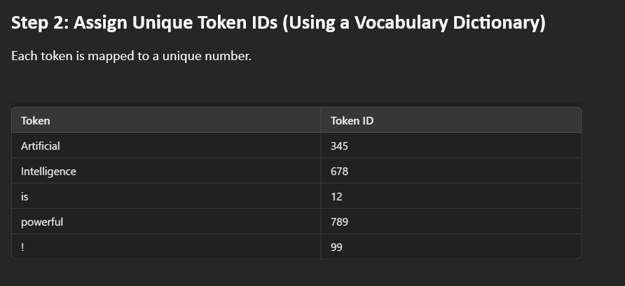
Step 1: Tokenization
📌 Sentence: "Artificial Intelligence is powerful!" 📌 Tokens: ["Artificial", "Intelligence", "is", "powerful", "!"]

Slide 5
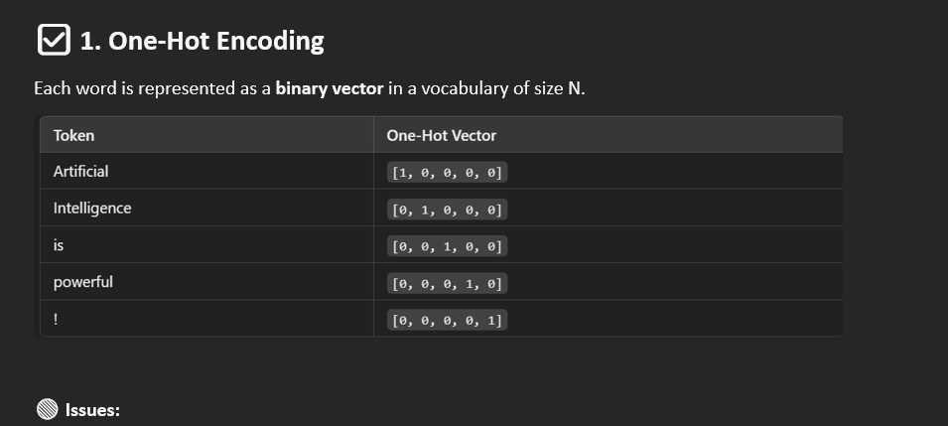

Slide 6
